Slide 1
UX Evaluation Introduction
CSCI4260

Slide 3
LTM Check
What do you remember about evaluation from last semester?

Slide 4
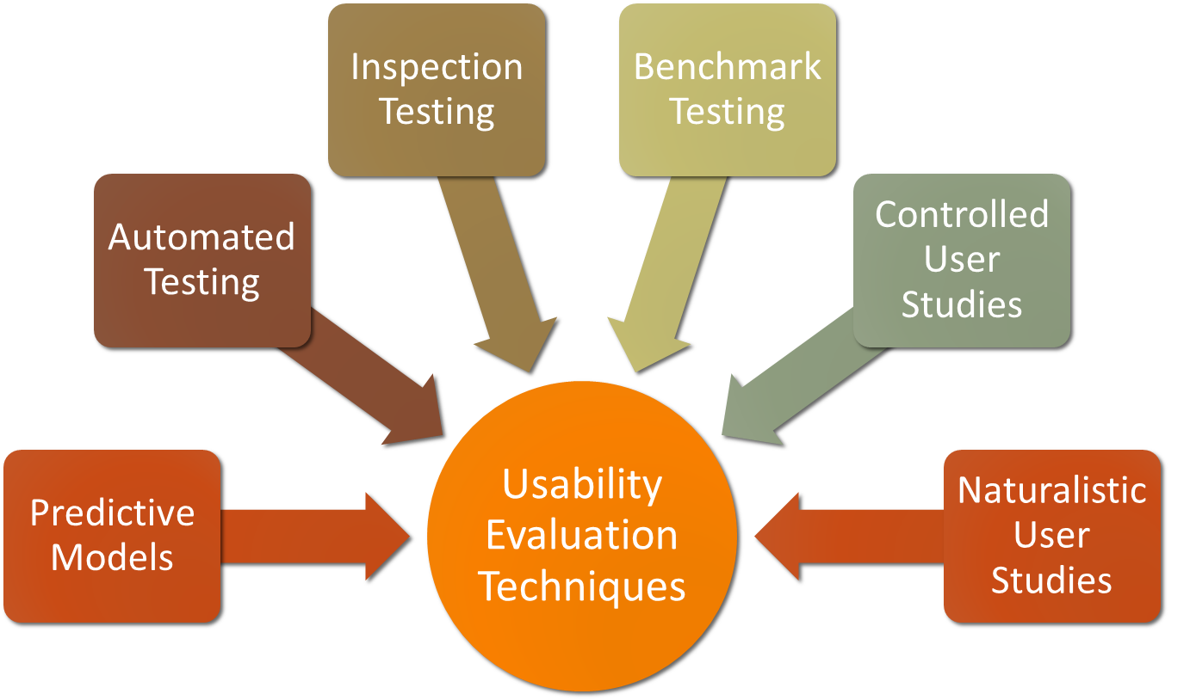
Usability Evaluation Techniques
Notes:
Some of the same techniques are used in evaluation as for establishing requirements but they are used differently
(e.g. observation interviews & questionnaires).
The main methods are: observing, asking users, asking experts, user testing, inspection, and modeling users’ task performance, analytics.
Dealing with constraints is an important skill for evaluators to develop.

Slide 5
Evaluation Goals
What are some typical goals we might have with UXD project?
What are some goals from the papers we’ve read so far this semester?
What are some goals that are directly applicable to your projects?

Slide 6
Formative vs. summative evaluation
Formative evaluation helps you form design
Summative evaluation helps you sum up design
“When the cook tastes the soup, that’s formative”
“When the guests taste the soup, that’s summative”

Slide 7
Formative evaluation
Diagnostic nature
Uses primarily qualitative data
Immediate goal: To identify UX problems and their causes in design
Ultimate goal: To fix the problems

Slide 8
Summative evaluation
Collecting quantitative data
  To assess level of user experience quality due to a design
  Especially for assessing improvement in user experience due to iteration of
    Formative evaluation
    Re-design

Slide 9
Formal summative evaluation
Comparative benchmark study based on rigorous experimental design aimed at comparing designs
Controlled experiment, hypothesis testing
Results subjected to statistical tests for significance
An important HCI skill, but not covered here

Slide 10
Informal summative evaluation
Partner of formative evaluation
  Example, measure time on task
  For engineering summing up or assessing of UX levels
Done without experimental controls

Slide 11
Informal summative evaluation
Usually without validity concerns, such as in sampling, degree of confidence
Usually with small number of participants
Only summary statistics (e.g., mean and variance)

Slide 12
Informal summative evaluation
Uses metrics for user performance
  As indicators of user performance
  As indicators of design quality
Metrics in comparison with pre-established UX target levels
(Chapter 10)

Slide 13
Informal summative evaluation
Results not validated
  Can be used only to guide engineering development process
  Cannot make any claims based on your result to your organization or to public
    An important ethical constraint

Slide 14
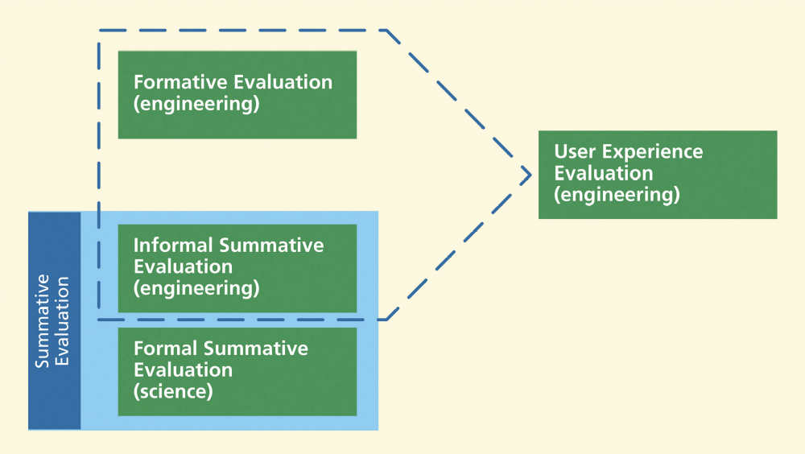
Engineering evaluation of UX
Formative plus informal summative

Slide 15
Types of UX evaluation methods
Orthogonal dimensions for classifying types
  Rigorous method vs. rapid method
  Empirical method vs. analytic method

Slide 16
Rigorous UX evaluation methods
Use full process
  Preparation, data collection, data analysis, and reporting
  Chapters 12 and 14 through 18
  Use no shortcuts or abridgements
When you need maximum effectiveness and thoroughness
  But expect it to be more expensive and time consuming
When you need to manage risk carefully

Slide 17
Rapid UX evaluation methods
Choose a rapid evaluation method
  For speed and cost savings
    But expect it to be (possibly acceptably) less effective
  For early stages of progress
    When things are changing a lot, anyway
    When investing in detailed evaluation is not warranted

Slide 18
Rapid UX evaluation methods
Choose a rapid method for initial reactions and early feedback
  Design walkthrough
  Informal demonstration of design concepts
Choose a rapid UX evaluation method if you are in this class ☺

Slide 19
Lab vs Field
Choose lab-based testing if you need controlled environment
  To limit distractions.
Choose empirical testing in field if you need more realistic usage conditions
  For ecological validity

Slide 20
Empirical method vs. analytic method
Another dimension for classifying types
Empirical methods
  Employ data observed in performance of real user participants
  Usually data collected in lab-based testing

Slide 21
Empirical method vs. analytic method
Analytical methods
  Based on looking at inherent attributes of design
  Rather than seeing design in use
Many rapid UX evaluation methods are analytic
  Example, design walkthroughs, UX inspection methods (heuristic eval, cog walkthrough)

Slide 22
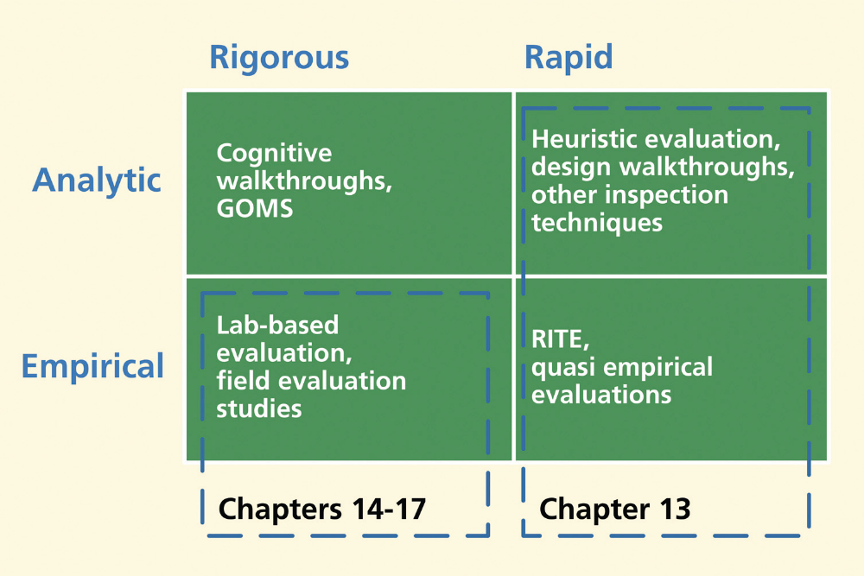
Where the dimensions intersect

Slide 23

Everyone with me?

Slide 24
Formative data collection techniques
Critical incident identification
Think-aloud technique
Both used in rigorous and rapid methods

Slide 25
Critical incident identification
A critical incident is an event observed within task performance
  Significant indicator of UX problem
  Due to effects of design flaws on users
Arguably single most important source of qualitative data in formative evaluation
Can be difficult until you learn to do it

Slide 26
Critical incident identification
Critical incident data
  Detailed and perishable
    Must be captured immediately and precisely as they arise during usage
  Essential for isolating specific UX problems
That is why alpha and beta testing might not be as effective for formative evaluation

Slide 27
Think-aloud technique
Participants let us in on their thinking
  Their intentions
  Rationale
  Perceptions of UX problems
User participants verbally express their thoughts during interaction experience
Also called “think-aloud protocol” or “verbal protocol”

Slide 28
Think-aloud technique
Useful for walk-through of prototype
Effective when participant helps with inspection
Effective in task performance within lab-based testing
Good for assessing internally felt emotional impact

Slide 29
Think-aloud technique
Needed when
  User hesitates
  A real UX problem is hidden from observation
Sometimes you have to remind participants to verbalize

Slide 30
Co-discovery think-aloud techniques
Use two or more participants together
It’s more natural to verbalize when discussing problems between them

Slide 31
Questionnaires
A self-reporting data collection technique
Primary instrument for collecting quantitative subjective data
Used to supplement objective data
An evaluation method on its own

Slide 32
Questionnaires
In past, have been used primarily to assess user satisfaction
  But can contain probing questions about total user experience
  Especially good for emotional impact, perceived usefulness
Inexpensive and easy to administer
But require skill to produce so that data are valid and reliable

Slide 33
Semantic differential scales
Also called Likert scales
Each question posed on range of values describing attribute
Most extreme value in each direction on scale is an anchor
Scale divided with points between anchors
  Divide up difference between anchor meanings

Slide 34
Semantic differential scales
Granularity of the scale
  Number of discrete points
  Including anchors
  The number of choices we allow users
Typical labeling of a point on a scale is verbal
  Often with associated numeric value
  Labels can also be pictorial
    Example, smiley faces
    Helps make it language-independent

Slide 35
Example, semantic differential scale
To assess participant agreement with this statement
  “The checkout process on this Website was easy to use.”
Might have these anchors: Strongly agree and strongly disagree

Slide 36
QUIS
Questionnaire for User Interface Satisfaction
One of earliest and most used
Organized around general categories: Screen, terminology, learning, system capabilities

Slide 37
QUIS
Many practitioners supplement QUIS with their own questions
  Specific to design being evaluated
There have been many extensions and variations
*But it’s not free!

Slide 38
System Usability Scale (SUS)
Just 10 questions
Alternates positive and negative questions
  Prevents answers without really considering the questions
Five-point Likert scale

Slide 39
Example, SUS questions
I think that I would like to use this system frequently
I found the system unnecessarily complex
I thought the system was easy to use
I would need technical support to be able to use this system
I found functions in this system integrated

Slide 40
Example, SUS questions
Too much inconsistency in this system
Most people would learn to use this system very quickly
I found system very cumbersome to use
I felt very confident using the system
I needed to learn a lot of things before I could get going

Slide 41
System Usability Scale (SUS)
Robust, extensively used
Widely adapted
In public domain
Technology independent

Slide 42
Adapting questionnaires
You can modify an existing questionnaire (many others on p450)
  Choosing a subset of questions
  Changing the wording in some questions
  Adding questions to address specific areas of concern
  Using different scale values
Warning: Modifying a questionnaire can damage its validity

Slide 43
Evaluating emotional impact
Data collection techniques especially for emotional impact
Can be “measured” indirectly in terms of its indicators
“Emotion is a multifaceted phenomenon”
  Expressed through feelings
  Verbal and non-verbal languages
  Facial expressions and other behaviors

Slide 44
Evaluating emotional impact
Emotional impact indicators
  Self-reported via verbal techniques
  Physiological responses observed
  Physiological responses measured

Slide 45
Self reporting of emotional impact
Most emotional impact involving aesthetics, emotional values, and simple joy of use
  Felt by user
  But not necessarily observed by evaluator
Self reporting can tap into these feelings

Slide 46
Self reporting of emotional impact
Concurrent self reporting
  Participants comment via think-aloud techniques on feelings and their causes in the user experience
Retrospective self-reporting
  Questionnaires (see AttrakDiff in book)
http://attrakdiff.de/index-en.html

Slide 47
Observing physiological responses
Self-reporting can be biased
  Human users cannot always access own emotions
So observe physiological responses to emotional impact encounters

Slide 48
Observing physiological responses
Usage can be teeming with user behaviors
  Head scratching, fidgeting, tapping fingers
  Gestural expressions, body language, posture
Usage can also be punctuated with facial expressions
  Ephemeral grimaces, smiles, body language

Slide 49
Observing physiological responses
Emotional “tells” of facial and bodily expressions can be
  Fleeting, subliminal
  Easily missed in real-time observation
To capture reliably
  Might make video recordings
  Do frame-by-frame analysis

Slide 50
Interpreting user behavior from video
Observations of physiological effects
  Difficult to connect with specific emotions and causes within interaction
Try to correlate with synchronized video of user behavior

Slide 51
Interpreting user behavior from video
Frame-by-frame reviewing tedious and time-consuming
May need analyst trained in identifying and interpreting expressions
  Even trained analyst cannot always make right call

Slide 52
Methods for interpreting facial expressions
Example, Facial Action Coding System
  Method for identifying, taxonomizing, and explaining facial expressions
  Common standard to categorize physical expression of emotions
  Based on contraction and relaxation of individual muscles
  Analyst must observe, use FACS to code it

Slide 53
Automatic recognition of facial expressions
“faceAPI”
  Face-tracking technology
  Image-processing software suite
  Video camera captures position and orientation of user facial features
  Computer vision software recognizes expressions
  Tags video stream of usage, along with state of application software

Slide 54
Bio-metrics
Instruments to detect and measure physiological responses
  Measure autonomic or involuntary bodily changes
  Triggered by nervous system responses
  To emotional impact within interaction events

Slide 55
Bio-metrics
Example bio-metrics, to measure changes in
  Heart rate
  Respiration
  Perspiration
  Eye pupil dilation

Slide 56
Evaluating phenomenological aspects of interaction
Phenomenological aspects of interaction involve emotional impact over time
  Not snapshots of usage
  Not about tasks but about human activities
  Users invite product into their lives
  Give it a presence in daily activities
    Example, how someone uses a smartphone in their life

Slide 57
Evaluating phenomenological aspects of interaction
Users build perceptions and judgment through exploration and learning
  As usage expands and emerges
Data collection techniques for phenomenological aspects
  Have to be longitudinal

Slide 58
Evaluating phenomenological aspects of interaction
Evaluation must be situated in real user activities, in the wild
But cannot be with a participant 24/7
Most of the time would be dead time, anyway
Events of interest tend to be episodic in bursts

Slide 59
Need for self-reporting
Self-reporting techniques often necessary
Not as objective as direct observation
  But a practical solution

Slide 60
Diaries in situated longitudinal studies
User takes notes to document within long-term usage:
  Problems
  Experiences
  Phenomenological occurrences

Slide 61
Diaries in situated longitudinal studies
Self-reporting data capture techniques
  Paper and pencil notes
  Online reporting, such as in a blog
  Cellphone voice-mail messages
  Pocket digital voice recorder
User must be
  Able to identify important events in long-term usage
  Willing to report immediately, while details are fresh

Slide 62
Evaluator-controlled timing
Evaluator triggered reporting for more representative data
  Example
    Signal user on pager at random times within usage

Slide 63
Periodic questionnaires
Periodic questionnaires over time
Call user in at selected times
Set up simulated usage situation
Use direct observation and interviews

